Slide 1
Chapter 11
E-Commerce Security

Slide 2
Learning Objectives
Explain EC-related crimes and why they cannot be stopped.
Describe an EC security strategy and why a life cycle approach is needed.
Describe the information assurance security principles.
Describe EC security issues from the perspective of customers and e-businesses.

Slide 3
Learning Objectives
Identify the major EC security threats, vulnerabilities, and risk.
Identify and describe common EC threats and attacks.
Identify and assess major technologies and methods for securing EC communications.
Identify and assess major technologies for information assurance and protection of EC networks.

Slide 4
Stopping E-Commerce Crimes
Information assurance (IA)
The protection of information systems against unauthorized access to or modification of information whether in storage, processing or transit, and against the denial of service to authorized users, including those measures necessary to detect, document, and counter such threats
human firewalls
Methods that filter or limit people’s access to critical business documents

Slide 5
Stopping E-Commerce Crimes
zombies
Computers infected with malware that are under the control of a spammer, hacker, or other criminal
application firewalls
Specialized tools designed to increase the security of Web applications
common (security) vulnerabilities and exposures (CVE)
Publicly known computer security risks, which are collected, listed, and shared by a board of security-related organizations (cve.mitre.org)

Slide 6
Stopping E-Commerce Crimes
vulnerability
Weakness in software or other mechanism that threatens the confidentiality, integrity, or availability of an asset (recall the CIA model). It can be directly used by a hacker to gain access to a system or network
risk
The probability that a vulnerability will be known and used

Slide 7
Stopping E-Commerce Crimes
exposure
The estimated cost, loss, or damage that can result if a threat exploits a vulnerability
standard of due care
Care that a company is reasonably expected to take based on the risks affecting its EC business and online transactions

Slide 8
Stopping E-Commerce Crimes
CSI/FBI Computer Crime and Security Survey
Annual security survey of U.S. corporations, government agencies, financial and medical institutions, and universities conducted jointly by the FBI and the Computer Security Institute

Slide 9
Stopping E-Commerce Crimes
Highlights from CSI/FBI Computer Crime and Security Survey:
  Total financial losses from attacks have declined dramatically
  Attacks on computer systems or (detected) misuse of these systems have been slowly but steadily decreasing in all areas
  Defacements of Internet Web sites have increased dramatically
  “Inside jobs” occur about as often as external attacks
  Organizations largely defend their systems through firewalls, antivirus software, intrusion detection systems, and server-based access control lists
  Organizations largely defend their systems through firewalls, antivirus software, intrusion detection systems, and server-based access control lists
  Computer security investments per employee vary widely

Slide 10
E-Commerce Security Strategy and Life Cycle Approach
The Internet’s Vulnerable Design
  domain name system (DNS)
  Translates (converts) domain names to their numeric IP addresses
  IP address
  An address that uniquely identifies each computer connected to a network or the Internet

Slide 11
E-Commerce Security Strategy and Life Cycle Approach
The Shift to Profit-Motivated Crimes
Treating EC Security as a Project
  EC security program
  Set of controls over security processes to protect organizational assets
  Four high-level stages in the life cycle of an EC security program:
    Planning and organizing
    Implementation
    Operations and maintenance
    Monitoring and evaluating

Slide 12
E-Commerce Security Strategy and Life Cycle Approach
Organizations that do not follow such a life cycle approach usually:
  Do not have policies and procedures that are linked to or supported by security activities
  Suffer disconnect, confusion, and gaps in responsibilities for protecting assets
  Lack methods to fully identify, understand, and improve deficiencies in the security program
  Lack methods to verify compliance to regulations, laws, or policies
  Have to rely on patches, hotfixes, and service packs because they lack a holistic EC security approach

Slide 13
E-Commerce Security Strategy and Life Cycle Approach
  patch
  Program that makes needed changes to software that is already installed on a computer. Software companies issue patches to fix bugs in their programs, to address security problems, or to add functionality
  hotfix
  Microsoft’s name for a patch. Microsoft bundles hotfixes into service packs for easier installation
  service pack
  The means by which product updates are distributed. Service packs may contain updates for system reliability, program compatibility, security, and more

Slide 14
E-Commerce Security Strategy and Life Cycle Approach
Ignoring EC Security Best Practices
  Computing Technology Industry Association (CompTIA)
  Nonprofit trade group providing information security research and best practices
  Despite the known role of human behavior in information security breaches, only 29% of the 574 government, IT, financial, and educational organizations surveyed worldwide had mandatory security training. Only 36%offered end-user security awareness training

Slide 15
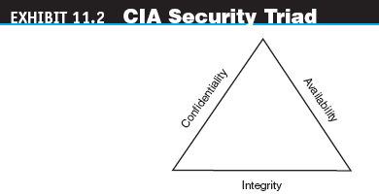
Information Assurance
CIA security triad (CIA triad)
Three security concepts important to information on the Internet: confidentiality, integrity, and availability

Slide 16
Information Assurance
confidentiality
Assurance of data privacy and accuracy. Keeping private or sensitive information from being disclosed to unauthorized individuals, entities, or processes
integrity
Assurance that stored data has not been modified without authorization; and a message that was sent is the same message that was received
availability
Assurance that access to data, the Web site, or other EC data service is timely, available, reliable, and restricted to authorized users

Slide 17
Information Assurance
authentication
Process to verify (assure) the real identity of an individual, computer, computer program, or EC Web site
authorization
Process of determining what the authenticated entity is allowed to access and what operations it is allowed to perform

Slide 18
Information Assurance
nonrepudiation
Assurance that online customers or trading partners cannot falsely deny (repudiate) their purchase or transaction
digital signature or digital certificate
Validates the sender and time stamp of a transaction so it cannot be later claimed that the transaction was unauthorized or invalid

Slide 19
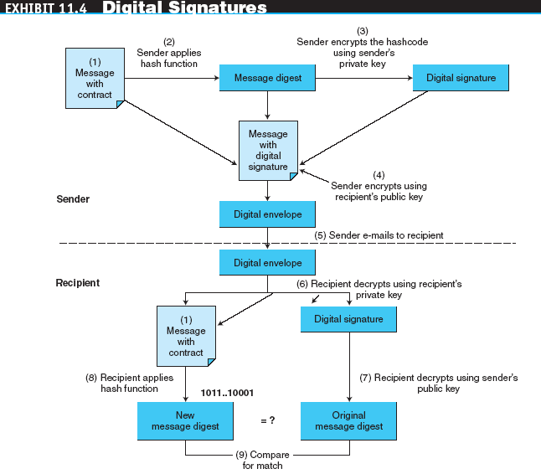
Information Assurance

Slide 20
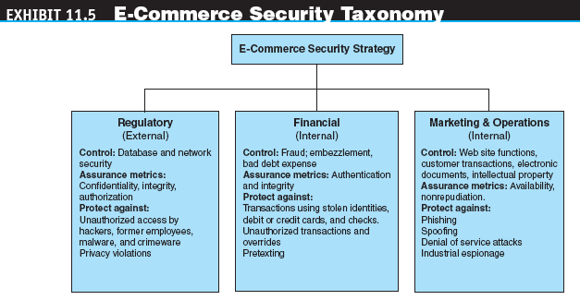
Information Assurance

Slide 21
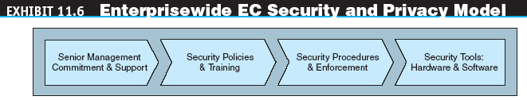
Enterprisewide E-Commerce Security and Privacy Model

Slide 22
Enterprisewide E-Commerce Security and Privacy Model
Senior Management Commitment and Support
EC Security Policies and Training
  To avoid violating privacy legislation when collecting confidential data, policies need to specify that customers:
    Know they are being collected
    Give permission, or “opt in,” for them to be collected
    Have some control over how the information is used
    Know they will be used in a reasonable and ethical manner

Slide 23
Enterprisewide E-Commerce Security and Privacy Model
acceptable use policy (AUP)
Policy that informs users of their responsibilities when using company networks, wireless devices, customer data, and so forth

Slide 24
Enterprisewide E-Commerce Security and Privacy Model
EC Security Procedures and Enforcement
  business impact analysis (BIA)
  An exercise that determines the impact of losing the support of an EC resource to an organization and establishes the escalation of that loss over time, identifies the minimum resources needed to recover, and prioritizes the recovery of processes and supporting systems
Security Tools: Hardware and Software

Slide 25
Basic E-Commerce Security Issues and Perspectives
Some of the major technology defenses to address these security issues that can occur in EC:
  Authentication
  Authorization
  auditing
  Process of recording information about what Web site, data, file, or network was accessed, when, and by whom or what
  Confidentiality (privacy) and integrity (trust)
  Availability
  Nonrepudiation

Slide 26
Threats and Attacks
nontechnical attack
An attack that uses chicanery to trick people into revealing sensitive information or performing actions that compromise the security of a network
social engineering
A type of nontechnical attack that uses some ruse to trick users into revealing information or performing an action that compromises a computer or network

Slide 27
Threats and Attacks
technical attack
An attack perpetrated using software and systems knowledge or expertise
time-to-exploitation
The elapsed time between when a vulnerability is discovered and the time it is exploited
SpywareGuide
A public reference site for spyware

Slide 28
Threats and Attacks
zero-day incidents
Attacks through previously unknown weaknesses in their computer networks
denial of service (DOS) attack
An attack on a Web site in which an attacker uses specialized software to send a flood of data packets to the target computer with the aim of overloading its resources

Slide 29
Threats and Attacks
Web server and Web page hijacking
botnet
A huge number (e.g., hundreds of thousands) of hijacked Internet computers that have been set up to forward traffic, including spam and viruses, to other computers on the Internet
malware
A generic term for malicious software
virus
A piece of software code that inserts itself into a host, including the operating systems, in order to propagate; it requires that its host program be run to activate it

Slide 30
Threats and Attacks
worm
A software program that runs independently, consuming the resources of its host in order to maintain itself, that is capable of propagating a complete working version of itself onto another machine
macro virus (macro worm)
A virus or worm that executes when the application object that contains the macro is opened or a particular procedure is executed
Trojan horse
A program that appears to have a useful function but that contains a hidden function that presents a security risk

Slide 31
Threats and Attacks
Trojan-Phisher-Rebery
A new variant of a Trojan program that stole tens of thousands of stolen identities from 125 countries that the victims believed were collected by a legitimate company
banking Trojan
A Trojan that comes to life when computer owners visit one of a number of online banking or e-commerce sites
rootkit
A special Trojan horse program that modifies existing operating system software so that an intruder can hide the presence of the Trojan program

Slide 32
Securing
E-Commerce Communications
access control
Mechanism that determines who can legitimately use a network resource
passive token
Storage device (e.g., magnetic strip) that contains a secret code used in a two-factor authentication system
active token
Small, stand-alone electronic device that generates one-time passwords used in a two-factor authentication system

Slide 33
Securing
E-Commerce Communications
biometric systems
Authentication systems that identify a person by measurement of a biological characteristic, such as fingerprints, iris (eye) patterns, facial features, or voice
public key infrastructure (PKI)
A scheme for securing e-payments using public key encryption and various technical components

Slide 34
Securing
E-Commerce Communications
encryption
The process of scrambling (encrypting) a message in such a way that it is difficult, expensive, or time-consuming for an unauthorized person to unscramble (decrypt) it
plaintext
An unencrypted message in human-readable form
ciphertext
A plaintext message after it has been encrypted into a machine-readable form

Slide 35
Securing
E-Commerce Communications
encryption algorithm
The mathematical formula used to encrypt the plaintext into the ciphertext, and vice versa
key (key value)
The secret code used to encrypt and decrypt a message
key space
The large number of possible key values (keys) created by the algorithm to use when transforming the message

Slide 36
Securing
E-Commerce Communications
symmetric (private) key system
An encryption system that uses the same key to encrypt and decrypt the message
Data Encryption Standard (DES)
The standard symmetric encryption algorithm supported by the NIST and used by U.S. government agencies until October 2000
Rijndael
An advanced encryption standard (AES) used to secure U.S. government communications since October 2, 2000

Slide 37
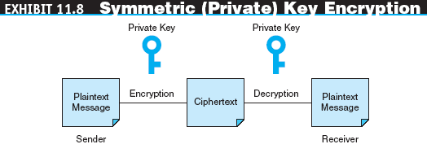
Securing
E-Commerce Communications

Slide 38
Securing
E-Commerce Communications
public (asymmetric) key encryption
Method of encryption that uses a pair of matched keys—a public key to encrypt a message and a private key to decrypt it, or vice versa
public key
Encryption code that is publicly available to anyone
private key
Encryption code that is known only to its owner
RSA
The most common public key encryption algorithm; uses keys ranging in length from 512 bits to 1,024 bits

Slide 39
Securing
E-Commerce Communications
hash
A mathematical computation that is applied to a message, using a private key, to encrypt the message
message digest (MD)
A summary of a message, converted into a string of digits after the hash has been applied
digital envelope
The combination of the encrypted original message and the digital signature, using the recipient’s public key
certificate authorities (CAs)
Third parties that issue digital certificates

Slide 40
Securing
E-Commerce Communications
Secure Socket Layer (SSL)
Protocol that utilizes standard certificates for authentication and data encryption to ensure privacy or confidentiality
Transport Layer Security (TLS)
As of 1996, another name for the SSL protocol

Slide 41
Securing
E-Commerce Networks
The selection and operation of technologies that ensure network security should be based on:
  Defense in depth
  Need-to-access basis
    policy of least privilege (POLP)
    Policy of blocking access to network resources unless access is required to conduct business
  Role-specific security
  Monitoring
  Patch management
  Incident response team (IRT)

Slide 42
Securing
E-Commerce Networks
FIREWALLS
  firewall
  A single point between two or more networks where all traffic must pass (choke point); the device authenticates, controls, and logs all traffic
  packet
  Segment of data sent from one computer to another on a network

Slide 43
Securing
E-Commerce Networks
Firewalls can be designed to protect against:
  Remote login
  Application backdoors
  SMTP session hijacking
  Macros
  Viruses
  Spam

Slide 44
Securing
E-Commerce Networks
packet-filtering routers
Firewalls that filter data and requests moving from the public Internet to a private network based on the network addresses of the computer sending or receiving the request
packet filters
Rules that can accept or reject incoming packets based on source and destination addresses and the other identifying information

Slide 45
Securing
E-Commerce Networks
application-level proxy
A firewall that permits requests for Web pages to move from the public Internet to the private network
bastion gateway
A special hardware server that utilizes application-level proxy software to limit the types of requests that can be passed to an organization’s internal networks from the public Internet

Slide 46
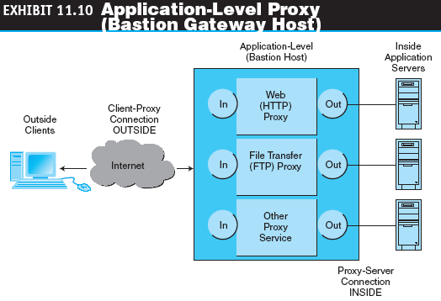
Securing
E-Commerce Networks

Slide 47
Securing
E-Commerce Networks
proxies
Special software programs that run on the gateway server and pass repackaged packets from one network to the other
demilitarized zone (DMZ)
Network area that sits between an organization’s internal network and an external network (Internet), providing physical isolation between the two networks that is controlled by rules enforced by a firewall

Slide 48
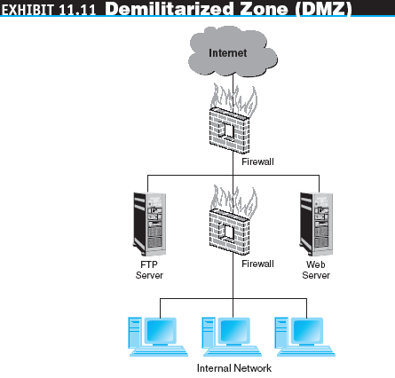
Securing
E-Commerce Networks

Slide 49
Securing
E-Commerce Networks
personal firewall
A network node designed to protect an individual user’s desktop system from the public network by monitoring all the traffic that passes through the computer’s network interface card
virtual private network (VPN)
A network that uses the public Internet to carry information but remains private by using encryption to scramble the communications, authentication to ensure that information has not been tampered with, and access control to verify the identity of anyone using the network
protocol tunneling
Method used to ensure confidentiality and integrity of data transmitted over the Internet, by encrypting data packets, sending them in packets across the Internet, and decrypting them at the destination address

Slide 50
Securing
E-Commerce Networks
intrusion detection systems (IDSs)
A special category of software that can monitor activity across a network or on a host computer, watch for suspicious activity, and take automated action based on what it sees
honeynet
A network of honeypots
honeypot
Production system (e.g., firewalls, routers, Web servers, database servers) that looks like it does real work, but which acts as a decoy and is watched to study how network intrusions occur

Slide 51
Managerial Issues
Why should managers learn about EC security?
Why is an EC security strategy and life cycle approach needed?
How should managers view EC security issues?
What is the key to establishing strong e-commerce security?
What steps should businesses follow in establishing a security plan?
Should organizations be concerned with internal security threats?

